Slide 1








Boosting Deepfake Detection with
Data Augmentation and DCT
Davide Alessandro Coccomini, Giuseppe Amato,
Fabrizio Falchi and Claudio Gennaro
DFAD 2023

Slide 2
Keypoints
Data Augmentation
Coccomini, D.A.; Zilos, G.K., Caldelli, R.; Falchi, F.; Amato G.; S. Papadopoulos; Gennaro, C.G. MINTIME: Multi-Identity Size-Invariant Video Deepfake Detection, Arxiv, 2022
Giudice, O.; Guarnera, L.; Battiato, S. Fighting Deepfakes by Detecting GAN DCT Anomalies. J. Imaging 2021, 7, 128.
Coccomini, D.A., Messina, N., Gennaro, C., Falchi, F. (2022). Combining EfficientNet and Vision Transformers for Video Deepfake Detection. In: Sclaroff, S., Distante, C., Leo, M., Farinella, G.M., Tombari, F. (eds) Image Analysis and Processing – ICIAP 2022. ICIAP 2022. Lecture Notes in Computer Science, vol 13233. Springer, Cham.
Architecture
Coccomini, D.A.; Caldelli, R.; Falchi, F.; Gennaro, C. On the Generalization of Deep Learning Models in Video Deepfake Detection. J. Imaging 2023, 9, 89.
Coccomini, D.A.; Caldelli, R.; Falchi, F.; Gennaro, C. Cross-Forgery Analysis of Vision Transformers and CNNs for Deepfake Image Detection, MAD '22: Proceedings of the 1st International Workshop on Multimedia AI against Disinformation, 2022
Evaluation
Coccomini, D.A.; Esuli A.; Falchi F.; Gennaro C.; Amato G. Detecting Images Generated by Diffusers

Slide 3

The Dataset

Slide 4
The Dataset
1 Million Pristine Images
1 Million Fake
Images
(Stable Diffusion)
50%
50%
Davide Alessandro Coccomini

Slide 5
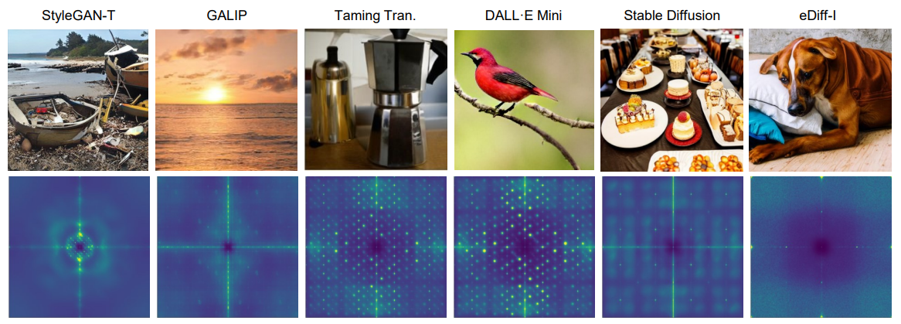
Fingerprint
Synthetic Images tends to have fingerprints
Frequency Domain
Riccardo Corvi, Davide Cozzolino, Giovanni Poggi, Koki Nagano, Luisa Verdoliva:
Intriguing properties of synthetic images: from generative adversarial networks to diffusion models

Slide 6

So just learn to detect Stable Diffusion fingerprint!!!
Davide Alessandro Coccomini

Slide 7


Slide 8


Generalization
Training
Model
Stable Diffusion
Image
Stable Diffusion
Image
Stable Diffusion
Image
Stable Diffusion
Image
Stable Diffusion
Image
Stable Diffusion
Image
Stable Diffusion
Image
Stable Diffusion
Image
Stable Diffusion
Image
Test
Model
Stable Diffusion
Image
Stable Diffusion
Image
GLIDE
Image
GLIDE
Image
Davide Alessandro Coccomini

Slide 9
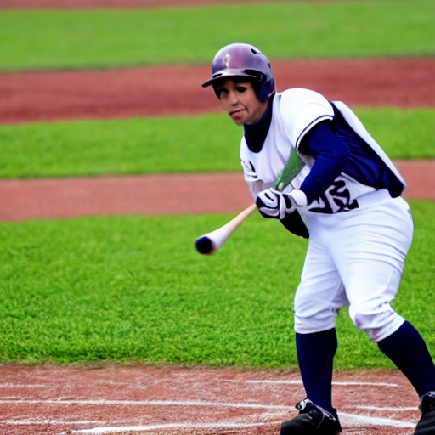
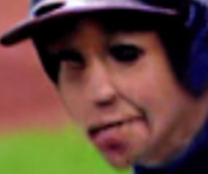
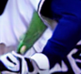

Detect the artifacts and inconsistencies
Davide Alessandro Coccomini

Slide 10

Model Architecture

Slide 11
Model Architecture
Resnet50
Convolutional-Only
Cross-Efficient Vision Transformer
Hybrid (Convolutional + Vision Transformer)
Swin-B
Hierarchical Vision Transformer
Davide Alessandro Coccomini

Slide 12
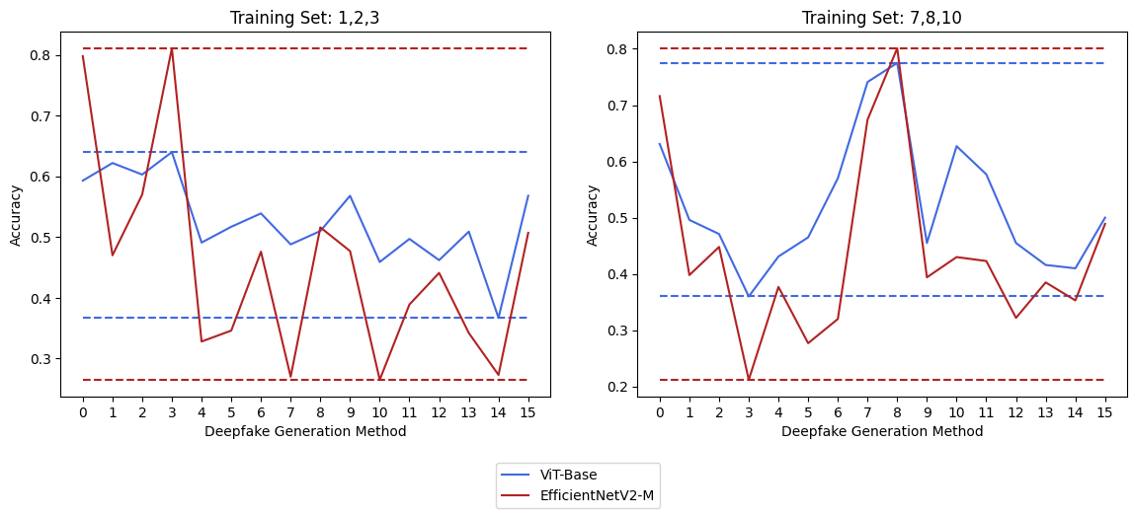
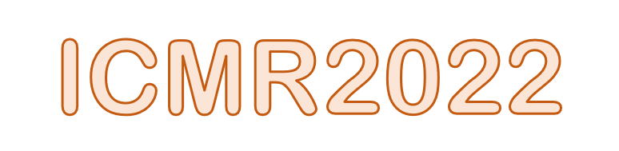
Cross-Forgery Analysis of Vision Transformers and CNNs for Deepfake Image Detection
Accuracy on ForgeryNet
Vision Transformers generalize better on Image Deepfake Detection!
Coccomini D.A., Caldelli R., Falchi F., Gennaro C., and Amato G. (2022). Cross-Forgery Analysis of Vision Transformers and CNNs for Deepfake Image Detection. In Proceedings of the 1st International Workshop on Multimedia AI against Disinformation (MAD '22). Association for Computing Machinery, New York, NY, USA, 52–58.

Slide 13
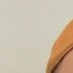
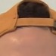
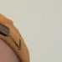
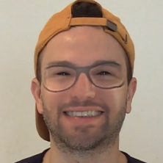
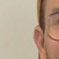

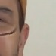
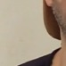
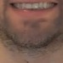
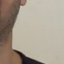
Vision Transformers
MLP
Head
CLASS
Transformer Encoder
0
*
1
2
3
4
5
6
7
8
9
1
2
3
Linear Projection of Flattened Patches
4
5
6
7
8
9

Slide 14
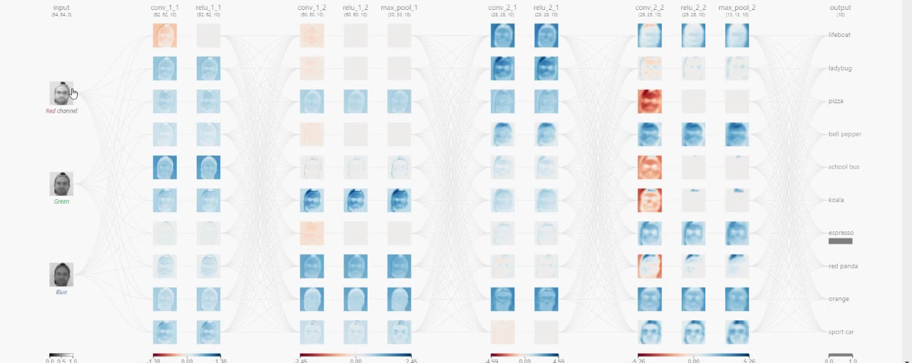
Create a patch extractor
…using EfficientNet B0

Slide 15
Cross Efficient Vision Transformer
Small or big patches? Both!
Deeper EfficientNet B0
Transformer Encoder
MLP
Cross-Attention
Mechanism
+
CLASS
Smaller EfficientNet B0
Transformer Encoder
MLP
Coccomini, D.A., Messina, N., Gennaro, C., Falchi, F. (2022). Combining EfficientNet and Vision Transformers for Video Deepfake Detection. In: Sclaroff, S., Distante, C., Leo, M., Farinella, G.M., Tombari, F. (eds) Image Analysis and Processing – ICIAP 2022. ICIAP 2022. Lecture Notes in Computer Science, vol 13233. Springer, Cham.

Slide 16

Preprocessing & Training

Slide 17
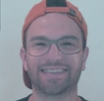
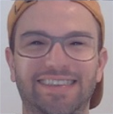
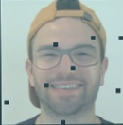
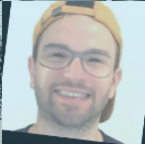

Random Transformations
Image Compression
Horizontal Flip | Rotate | Shift | Scale
Shadow | Gamma | Sepia | Gray
Brightness | Contrast | Saturation
Cutout | Dropout
Gaussian Noise | ISO Noise | Multiplicative Noise

Slide 18
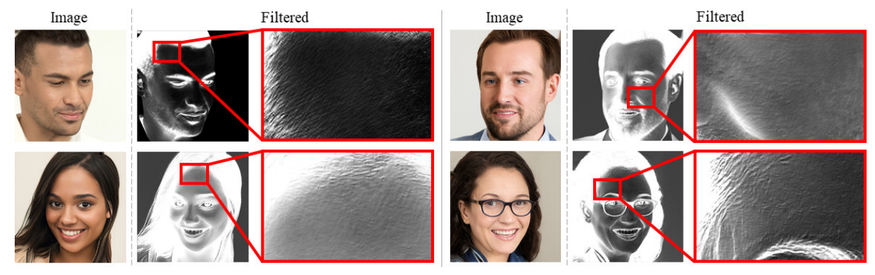
DCT Transform
Giudice, O.; Guarnera, L.; Battiato, S. Fighting Deepfakes by Detecting GAN DCT Anomalies. J. Imaging 2021, 7, 128.

Slide 19
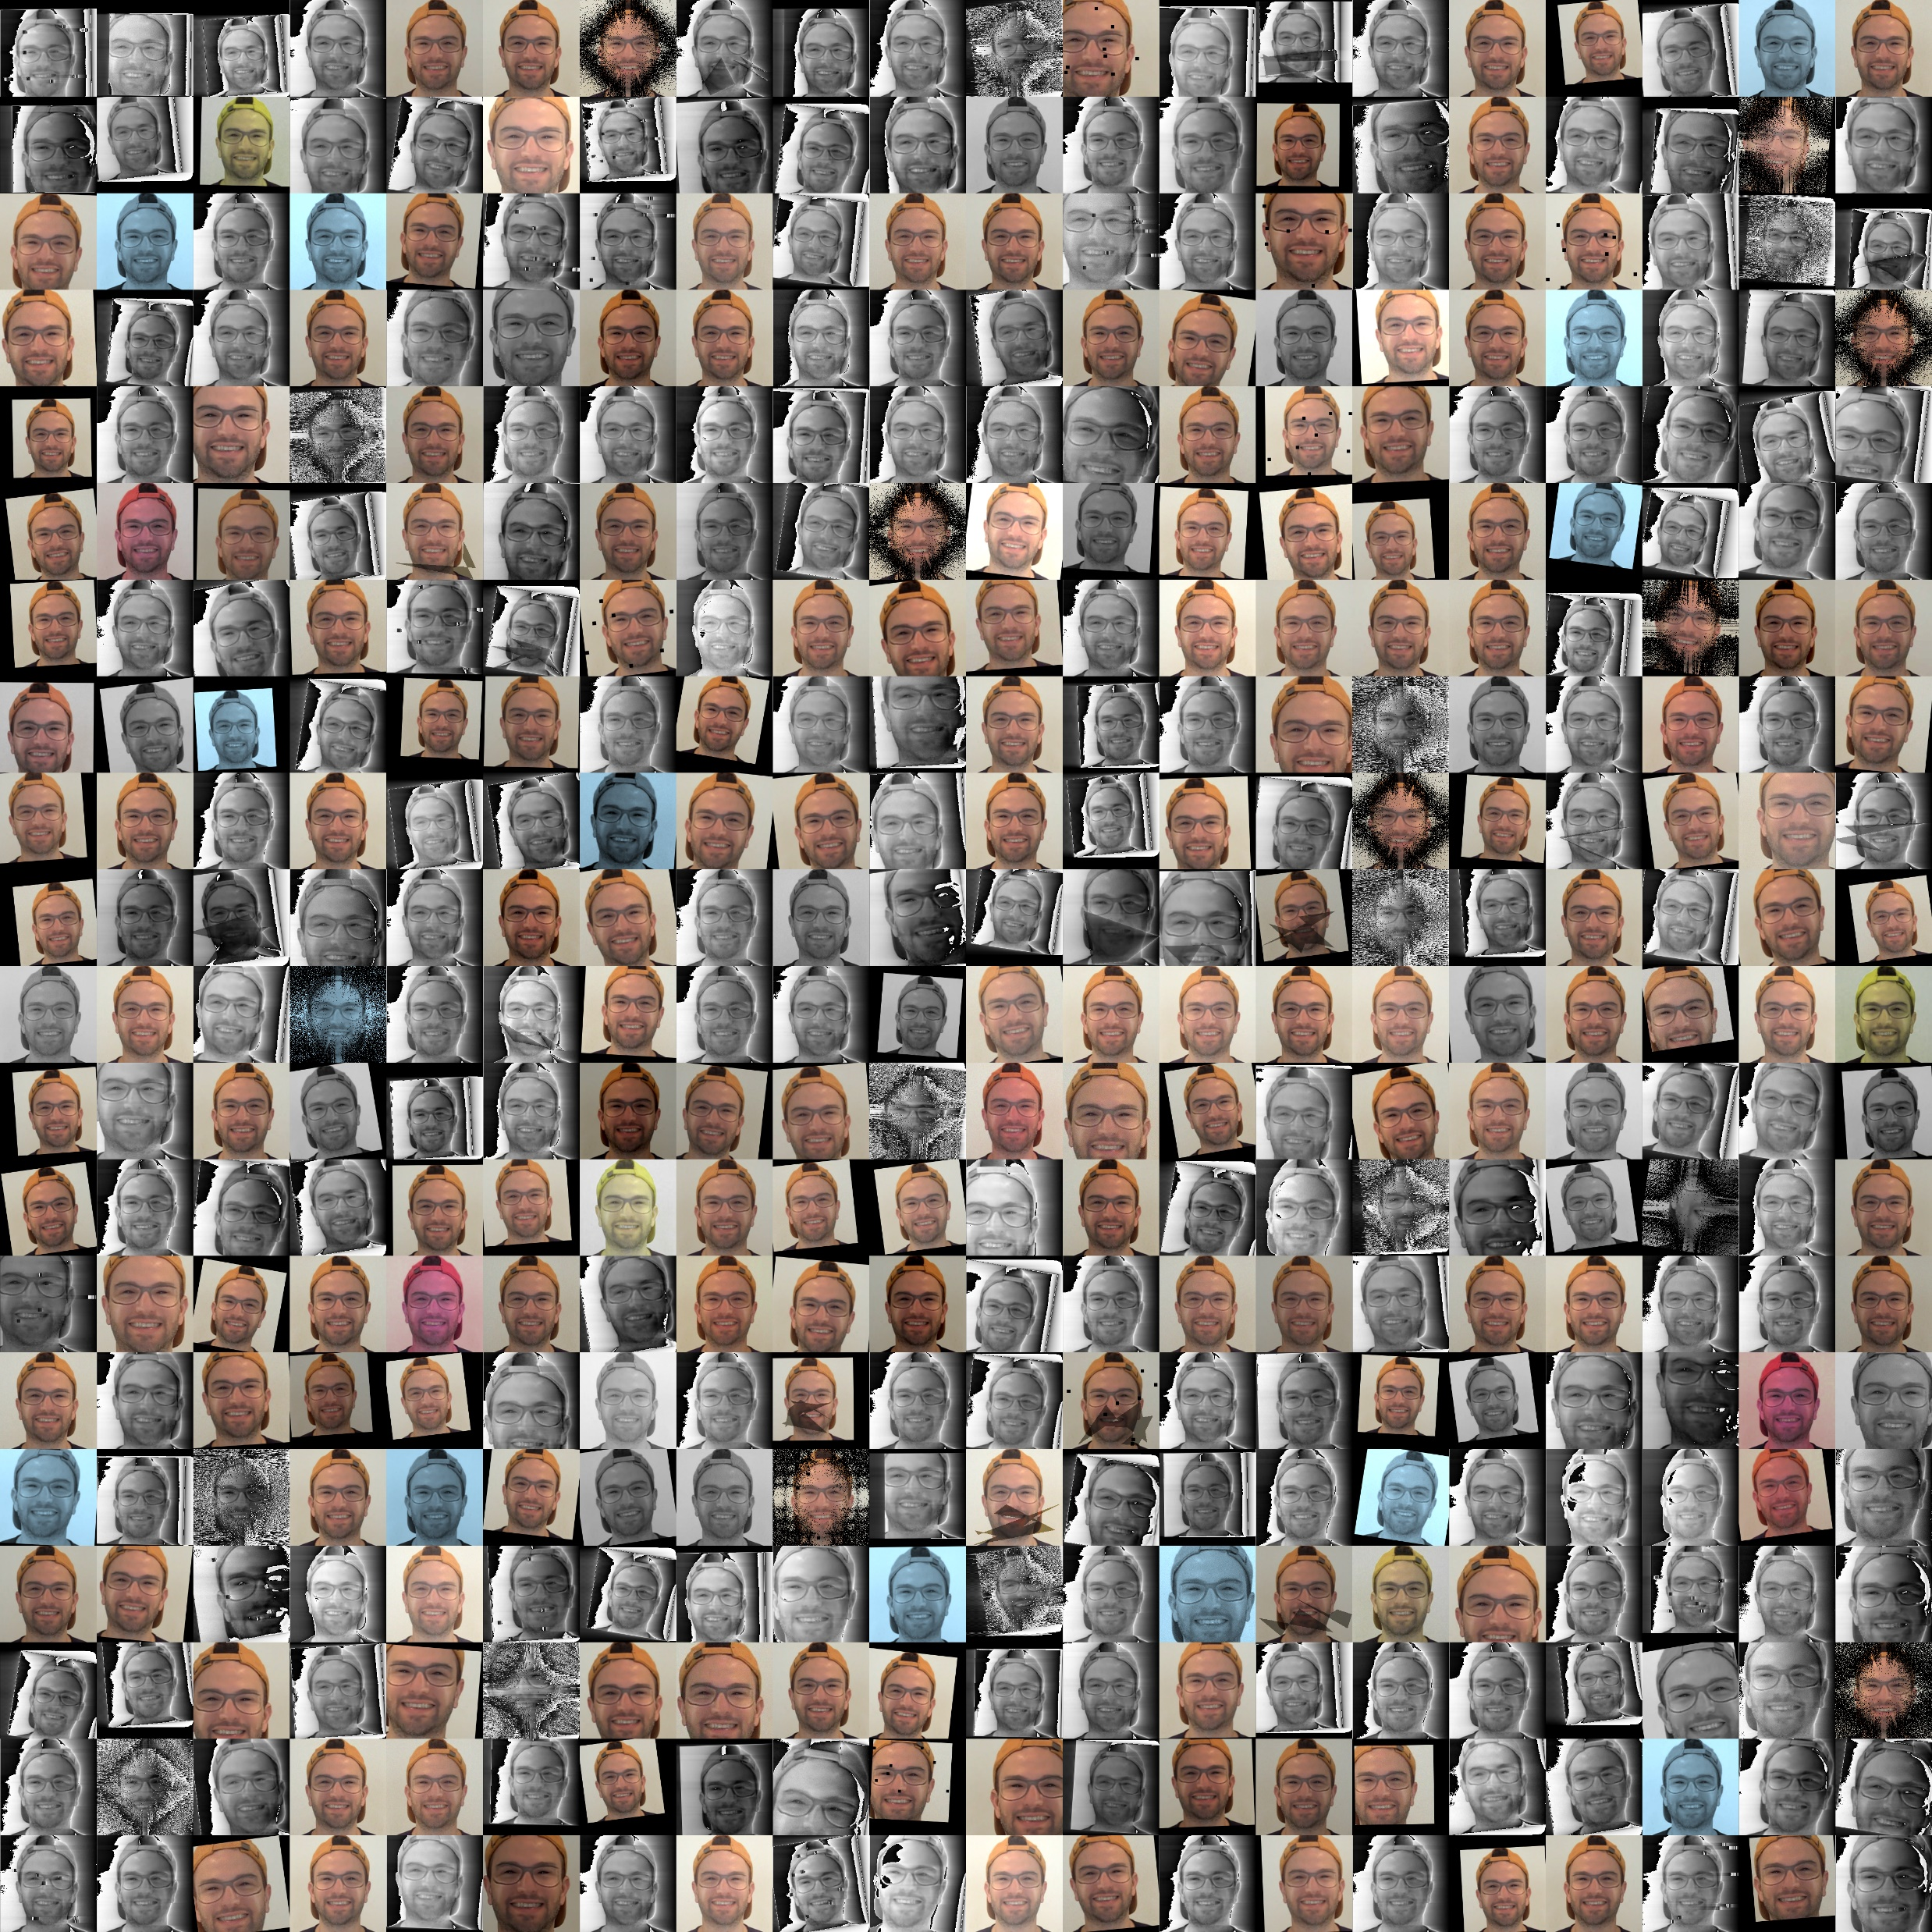
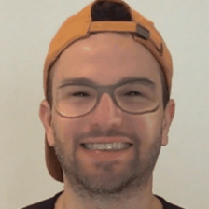

Slide 20

Evaluation

Slide 21
Competition Results
Swin-B DCT
1°
Cross Efficient ViT
2°
97.7% F1-Score
“Hierarchical” Vision Transformer
Huge Pretraining
86M parameters
Resnet50
3°
92.4% F1-Score
Conv + ViT
No Pretraining
101M parameters
88.5% F1-Score
CNN
Basic Pretraining
23M parameters

Slide 22
What contributed
Pretraining
Attention-based
Data Augmentation
Number of parameters

Slide 23
The Validation Set
DiffusionDB
MSCOCO
GLIDE from MSCOCO captions
1000
1500
1000
GLIDE from Wikimedia captions
1000
Wikimedia
1500
Stable Diffusion 1.4 from MSCOCO captions
750
Stable Diffusion 1.4 from Wikimedia captions
750
500
StyleGAN2
500
3500
500
500
Flickr Dataset
StyleGAN
RelGAN
ProGAN
Davide Alessandro Coccomini

Slide 24
Per-class Accuracy
Pristine
Stable Diffusion
GLIDE
95%
91%
25%
StyleGAN
StyleGAN2
ProGAN
RelGAN
10%
9%
1%
11%

Slide 25


Thank You
Any question?
Davide Alessandro Coccomini, Giuseppe Amato,
Fabrizio Falchi and Claudio Gennaro
DFAD 2023

